Slide 1
The Black Bisexual Experience presented by BiNet USA

Slide 2
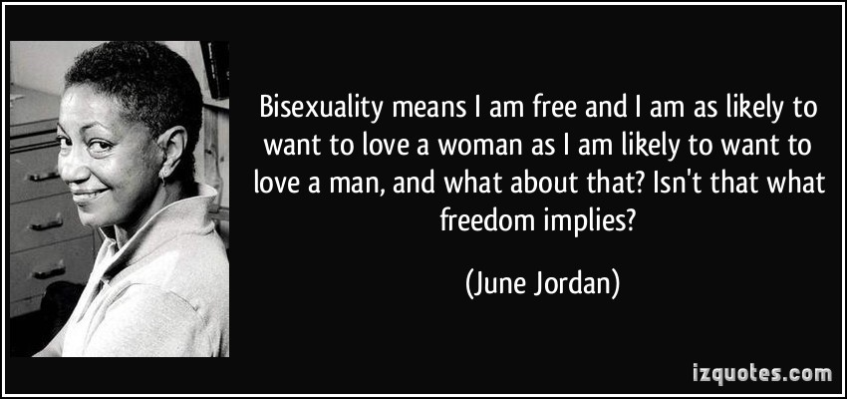
Bisexual, bi definition
“Bisexuals are people who acknowledge in themselves the potential to be attracted – romantically and/or sexually – to people of more than one sex and/or gender, not necessarily at the same time, not necessarily in the same way, and not necessarily to the same degree.” – Robyn Ochs
© Robyn Ochs www.robynochs.com

Slide 3
Rich historical significance
From the 1990 Bisexual Manifesto:
Bisexuality is a whole, fluid identity. Do not assume that bisexuality is binary or duogamous in nature: that we have "two" sides or that we must be involved simultaneously with both genders to be fulfilled human beings. In fact, don’t assume that there are only two genders. Do not mistake our fluidity for confusion, irresponsibility, or an inability to commit. Do not equate promiscuity, infidelity, or unsafe sexual behavior with bisexuality. Those are human traits that cross all sexual orientations. Nothing should be assumed about anyone’s sexuality, including your own.

Slide 4
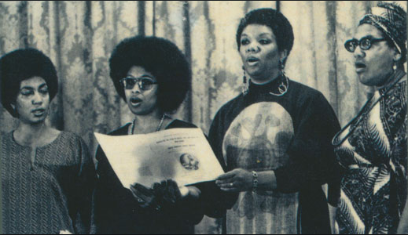
Black bisexual Icon: June Jordan
In 1991, black bisexual theorist and poet June Jordan called the bisexual movement a "mandate for revolutionary Americans planning to make it into the twenty-first century on the basis of the heart, on the basis of an honest human body, consecrated to every struggle for justice, every struggle for equality, every struggle for freedom".
June Jordan, Alice Walker, Lucille Clifton, and Audre Lorde together at the 1979 Phyllis Wheatley Poetry Festival

Slide 5
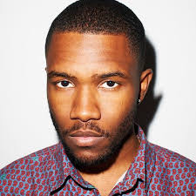
Labels are important to us
Bisexual is a Community Identity Label (similar to “lesbian,” “gay,” “straight,” or “queer”).
Many bisexuals use Personal Identity Labels that serve a vital function in describing differences while giving each individual a space to be unique.
Personal Identity Labels can include (but would never be limited to): fluid, multisexual, non-monosexual, pansexual, polysexual, pomosexual, and omnisexual.
Singer/Songwriter Frank Ocean sparked bi label conversations upon coming out in 2012

Slide 6
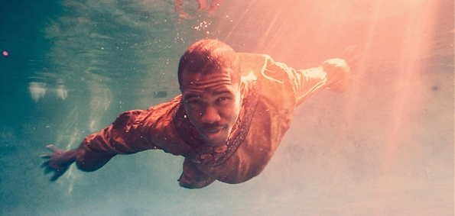
Label Conversations Are A Community Exercise
“Bisexual or Pansexual?” can be considered equivalent to internal community conversations many gay and lesbian people also have (e.g. “masculine,” “butch,” “femme,” or “queer”).
The internal conversation between bi, pan, fluid, queer community members about labels should not be used as a rationale for not serving the needs of the same community.
"I wrote an open letter that used the word “fluid” and “bisexual” to describe what Frank Ocean described in his letter. I also asked him if he minded the description of "bisexual," he told me he did not. – dream hampton, writer
http://dreamhampton1.tumblr.com/post/26767358662/i-wrote-an-open-letter-that-used-the-word-fluid

Slide 7
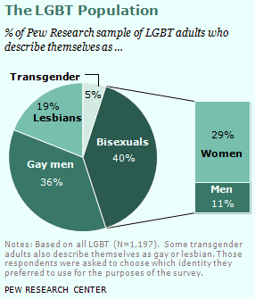
Bisexual Population In the U.S.
Williams Institute guidelines recommend using bisexual when collecting LGBT data, and BiNet USA recommends using bisexual when developing resources or support opportunities.
Transgender people can also be straight, gay, lesbian, bisexual, queer or asexual. Please allow them to id as such.
Add a “bi-claimer” whenever possible:
“The term bisexual will be used as an inclusive term to mean romantic and/or sexual attraction to more than one gender, and includes pansexual, fluid, omnisexual, and queer self-identifications”.

Slide 8
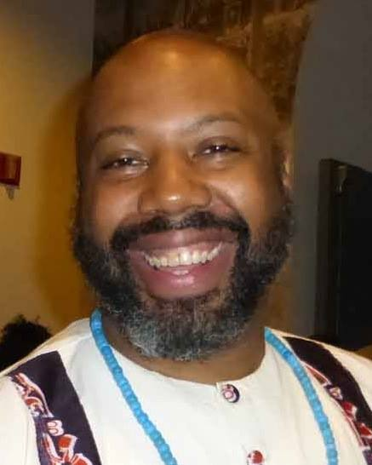
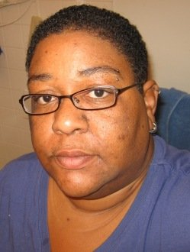
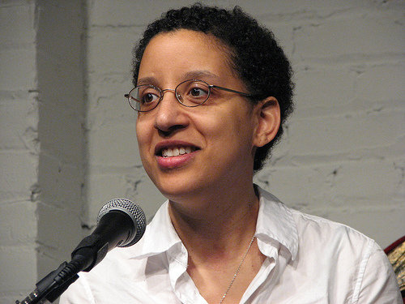
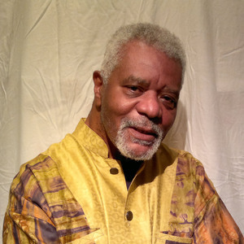
Bi coming out process is unique
More stages
Coming out later in life
Final stage is different and includes continued “identity maintenance”
© Bi Psychologist Dr. Mimi Hoang, drmimihoang@gmail.com
Some black bisexual leaders working in the U.S. today: Dr. Herukhuti, co-founder of The Center for Culture, Sexuality and Spirituality, Denise Ingram, co-founder of Bi Activist Facebook Group (600+ members) and BiUnity Philadelphia Leader, Amy Andre, Bisexual Health Expert, and ABilly S. Jones-Hennin Black LGBT Icon.

Slide 9
Bisexual policy priority: Health
Higher rate of tobacco use, compared to heterosexuals, lesbians and gays.
Higher rate of anxiety or mood disorder compared to heterosexuals, lesbians and gays.
Bisexual women are the most likely to have never had a cancer screening (mammogram or pap test) compared to heterosexuals or lesbians.
Bisexual women have more risk factors for heart disease compared to heterosexuals or lesbians.
Best health in relation to sexual orientation
Heterosexuals
Gays and Lesbians
Poorest health in relation to sexual orientation
Bisexuals
Source: Out For Health, Healthy People 2020 Bisexual Fact Sheet
Notes:
Click for each bullet to appear (5 bullets)

Slide 10
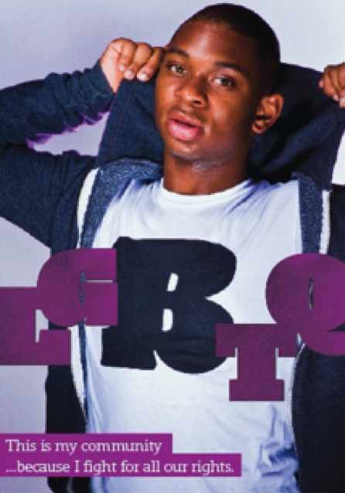
Bisexual policy priority: Mental Health
Bisexuals suffer higher rates of every mood and anxiety disorder.
Bisexuals also had more anger, self-injury, suicidal ideation and suicide attempts.
Among women, bisexual women had highest prevalence of PTSD (26.6% versus 6.6% of the heterosexual reference group).
“..the high prevalence of PTSD among sexual minorities in early adulthood potentially sets the stage for poorer health throughout adulthood” - American Journal of Public Health, 2012
Source: Out For Health, Healthy People 2020 Bisexual Fact Sheet
Example of a bisexual anti-stigma campaign http://www.rainbowhealthontario.ca/rhostore
Notes:
Click for each bullet to appear (4 bullets).

Slide 11
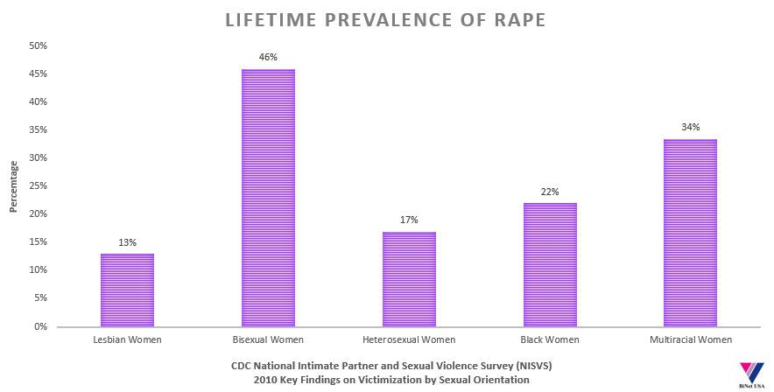
Bisexual policy priority: Sexual/Physical Violence
Most studies reveal that approximately 50% of transgender people experience sexual violence at some point in their lifetime – Journal of Aggression and Violent Behavior
Sources: Walters, M.L., Chen J., & Breiding, M.J. (2013). The National Intimate Partner and Sexual Violence Survey (NISVS): 2010 Findings on Victimization by Sexual Orientation. Atlanta, GA: National Center for Injury Prevention and Control, Centers for Disease Control and Prevention.
Notes:
Click for each bullet to appear (4 bullets).

Slide 12
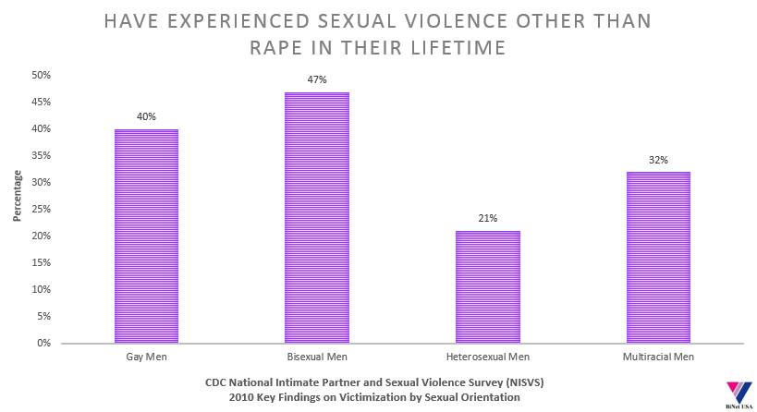
Sexual Violence is a Universal Disparity
Notes:
Click for each bullet to appear (4 bullets).

Slide 13
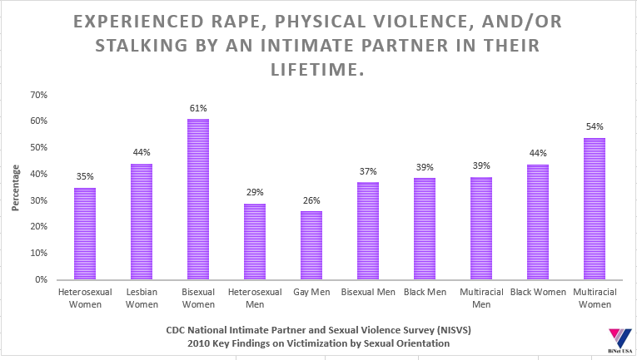
Intimate partner violence
Notes:
Click for each bullet to appear (4 bullets).

Slide 14
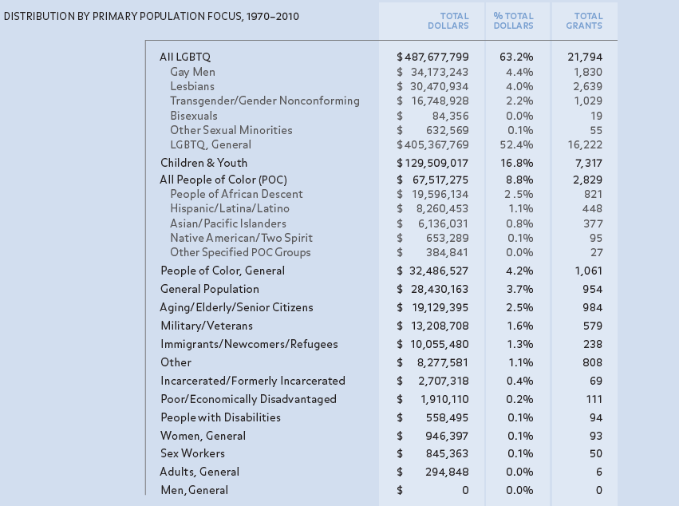
Funding disparities present in both public and private service providers and funders
Source, "40 Years Of LGBT Philanthropy" by LGBTFunders.com

Slide 15
The “Broken Bargain for LGBT Workers of Color” affects bisexuals too.
LGBT Movement Advancement Project Report (co-sponsored by NBJC): http://www.lgbtmap.org/workers-of-color

Slide 16
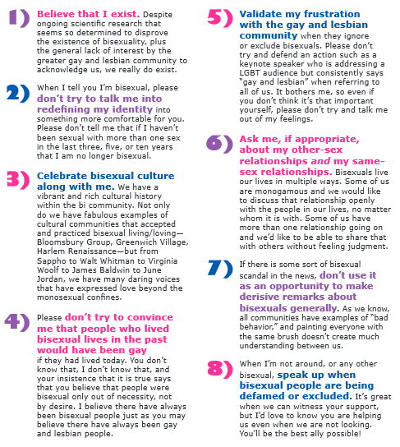
How To Be A Bi Ally
Black bisexual identified folks can also join BiNet USA’s new Black Bisexual Collective (BBC*) mailing list. https://groups.google.com/a/binetusa.org/forum/#!forum/bbc
Join us on: Facebook/com/groups/bipeopleofcolor
Facebook/com/groups/binetusa
Source: How To Be Bi Ally Brochure from the Bisexual Resource Center http://www.biresource.net/Bi_Ally_Brochure.pdf
Notes:
Click for each bullet to appear (4 bullets).

Slide 17
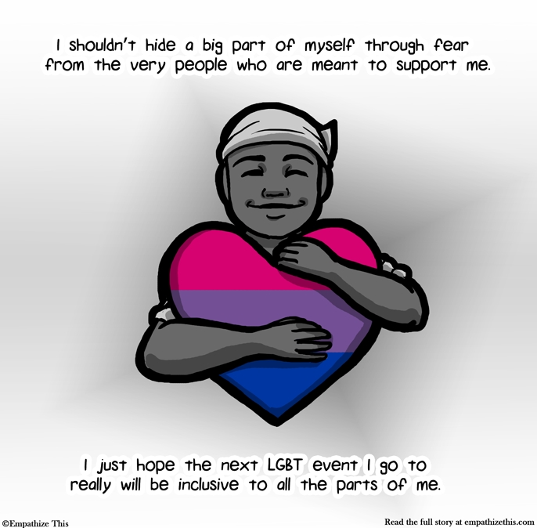
In Summary
Bisexual people have the capacity to be attracted to more than one gender.
The coming out process is often different than the gay/lesbian coming out experience.
The bisexual community movement is one based in honoring the complexity of sexuality.
Bisexual labels are important and diverse, much like the large population of bi people in the U.S.
Bisexual Public Policy Priorities center around the extraordinary level of disparities that bi people report facing in the areas of health, mental health and physical/sexual violence.
Being an ally to bisexual people starts with basic respect for the orientation and affirmation of the bisexual community.
Perspective from a black bisexual woman in the UK

