Slide 1
Bisexual Community Presentation

Slide 2
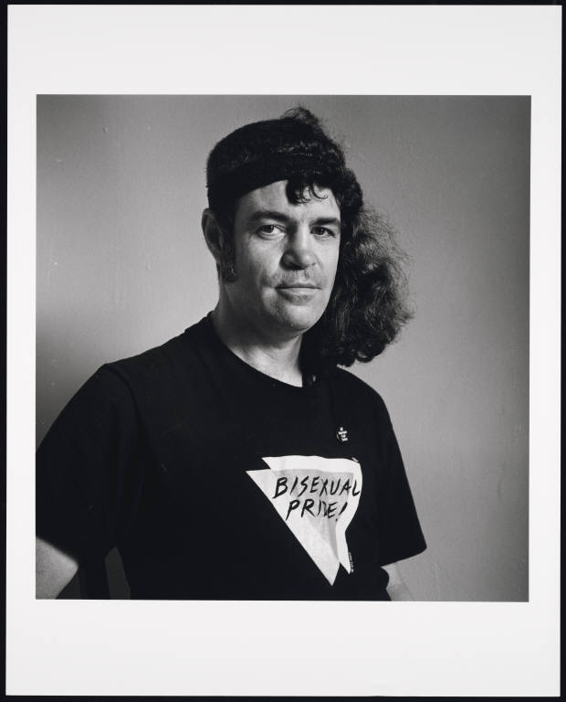
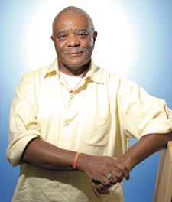
Important moments in bi history
1966 - First U.S. student gay rights group is co-founded by bisexual activist, Stephen Donaldson. Donaldson feels forced out of the gay movement after an affair with a leader from Daughter of Bilitis, the first lesbian civil rights group.
1969 - Brenda Howard (know as "Mother of Pride") conceives and coordinates a week of "PRIDE" activities to commemorate the Stonewall riots.
1974 - Dr. Fritz Klein publishes The Bisexual Option: A concept of one-hundred percent intimacy, goes on to found American Institute of Bisexuality and Journal of Bisexuality.
1977 - Alan Rockway, a psychologist and bisexual activist, co-authors the nation's first successful gay rights ordinance put to public vote, in Dade County, Florida.
1979 - Black LGBT icon and bisexual activist ABilly S. Jones-Hennin serves as logistics coordinator for first National March on Washington for Lesbian and Gay Rights.
Left: Stephen Donaldson
Below: ABilly S. Jones-Hennin

Slide 3
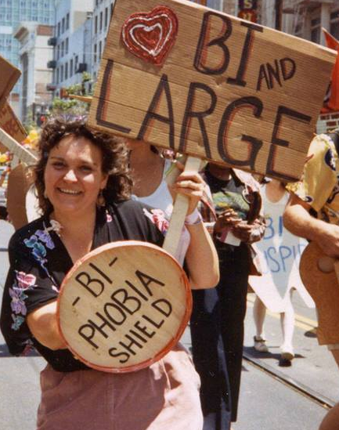
MORE MOMENTS IN BI HISTORY
1984 - After a two year battle, BiPOL activist, AIDS educator, and therapist Dr. David Lourea persuades the San Francisco Department of Public Health to recognize bisexual men in their official AIDS statistics.
1987 - A contingent of 75 bisexuals marches in the 1987 March On Washington For Gay and Lesbian Rights. The first national bisexual organization is conceived at this gathering, The North American Bisexual Network. NABN would later change its name to BiNet USA.
1992 - The Bisexual Connection (Minnesota) sponsors the First Annual Midwest Regional Bisexual Conference. BECAUSE (Bisexual Empowerment Conference: A Uniting, Supportive Experience) has run every year since.
1993 - Originally founded in 1985, The East Coast Bisexual Network revises its mandate and changes its name to the Bisexual Resource Center (BRC).
1999 - BiNet USA coordinators Michael Page, Gigi Raven Wilbur, and Wendy Curry organize the first Celebrate Bisexuality Day which utilizes the Bisexual Pride Flag Michael Page created in 1998.
Image courtesy of "Biconic Flashpoints: 4 Decades of Bay Area Bisexual Politics" history exhibit at GLBT History Museum in SF

Slide 4
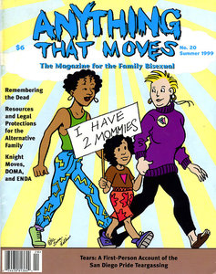
bisexual = historical significance
From the 1990 Bisexual Manifesto:
Bisexuality is a whole, fluid identity. Do not assume that bisexuality is binary or duogamous in nature: that we have "two" sides or that we must be involved simultaneously with both genders to be fulfilled human beings. In fact, don’t assume that there are only two genders. Do not mistake our fluidity for confusion, irresponsibility, or an inability to commit. Do not equate promiscuity, infidelity, or unsafe sexual behavior with bisexuality. Those are human traits that cross all sexual orientations. Nothing should be assumed about anyone’s sexuality, including your own.

Slide 5
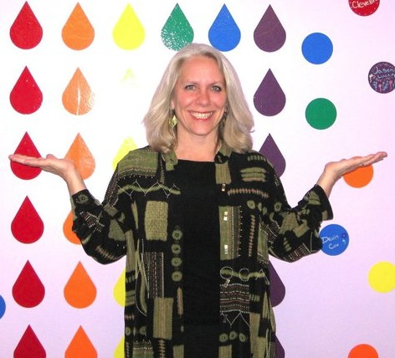
Bisexual definition
“Bisexuals are people who acknowledge in themselves the potential to be attracted – romantically and/or sexually – to people of more than one sex and/or gender, not necessarily at the same time, not necessarily in the same way, and not necessarily to the same degree.” – Robyn Ochs
© Robyn Ochs www.robynochs.com

Slide 6
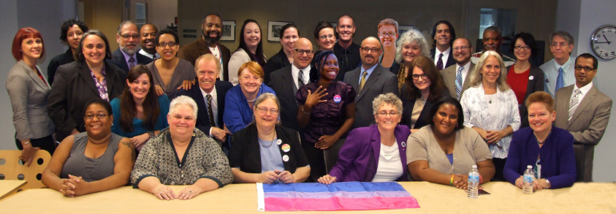
Bi coming out process is unique
More stages than gay/lesbian coming out
Final stage is different and includes continued “identity maintenance”
Coming out later in life
Pic: 2013 Bi Community Issues Roundtable at the White House Attendees
© Bi Psychologist Dr. Mimi Hoang, drmimihoang@gmail.com

Slide 7
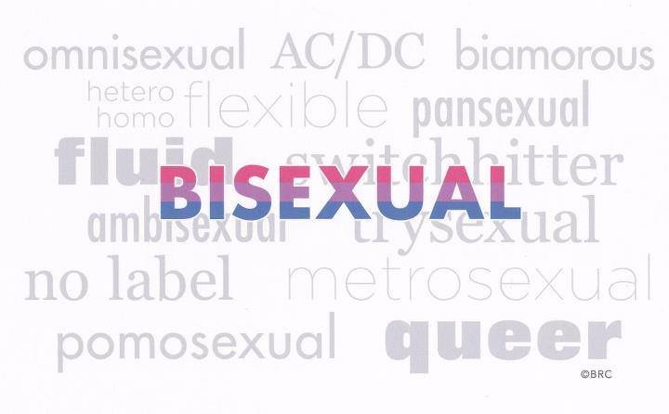
Labels are important to us
Bisexual is a Community Identity Label (similar to “lesbian,” “gay,” “straight,” or “queer”).
Many bisexuals use Personal Identity Labels that serve a vital function in describing differences while giving each individual a space to be unique.
Personal Identity Labels can include (but would never be limited to): fluid, multisexual, non-monosexual, pansexual, polysexual, pomosexual, and omnisexual.
The internal conversation between bi, pan, fluid, queer community members about labels should not be used as a rationale for not serving the needs of the same community.
Image courtesy of The Bisexual Resource Center

Slide 8
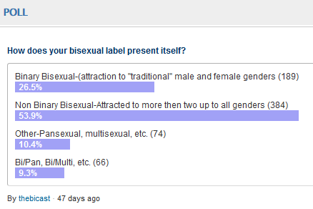
Bisexual identities
“Bisexual or Pansexual?” can be considered equivalent to internal community conversations many gay and lesbian people have regarding personal approaches (e.g. “masculine,” “butch,” or “femme”).
Don’t “identity police” but DO spend time acknowledging the diversity that exists within the “B in LGBT”
Bi people can “come out” while in a same-sex or different sex relationship. Coming out as bisexual does not itself indicate a person’s relationship status (e.g. single) or relationship type (e.g. monogamous).
2014 Poll on bisexual labels by The BiCast (a bi podcast)

Slide 9
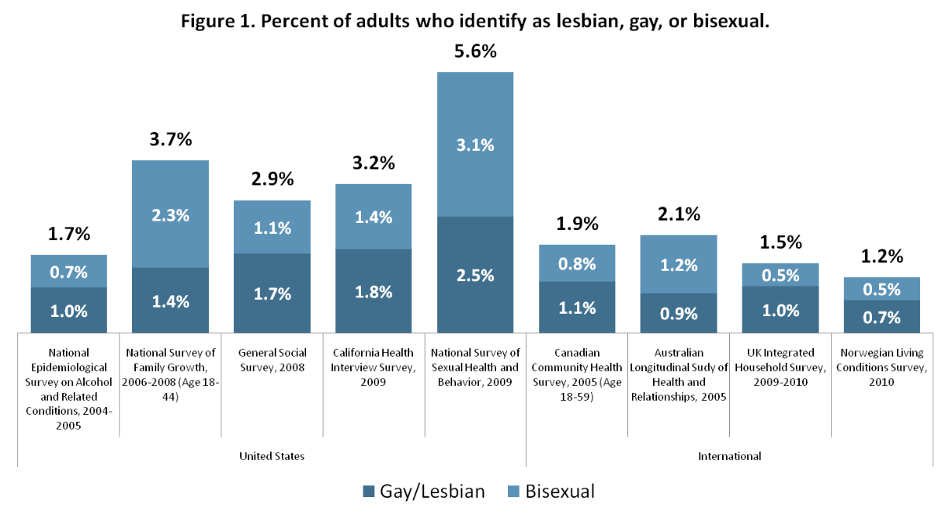
The b is important for the lgbt community
Source, Williams Institute

Slide 10
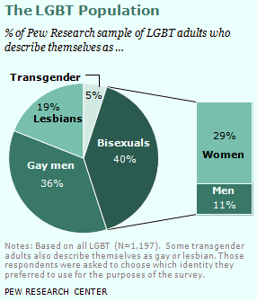
Bisexual Data collection
Williams Institute guidelines recommend using bisexual when collecting LGBT data, and BiNet USA recommends using bisexual when developing resources or support opportunities.
Transgender people can also be straight, gay, lesbian, bisexual, queer or asexual. Please allow them to id as such.
Add a “bi-claimer” whenever possible:
“The term bisexual will be used as an inclusive term to mean romantic and/or sexual attraction to more than one gender, and includes pansexual, fluid, omnisexual, and queer self-identifications”.

Slide 11
We Face Extreme Health Disparities
Higher rate of tobacco use, compared to heterosexuals, lesbians and gays.
Higher rate of anxiety or mood disorder compared to heterosexuals, lesbians and gays.
Bisexual women are the most likely to have never had a cancer screening (mammogram or pap test) compared to heterosexuals or lesbians.
Bisexual women have more risk factors for heart disease compared to heterosexuals or lesbians.
Best health in relation to sexual orientation
Heterosexuals
Gays and Lesbians
Poorest health in relation to sexual orientation
Bisexuals
Source: Out For Health, Healthy People 2020 Bisexual Fact Sheet
Notes:
Click for each bullet to appear (5 bullets)

Slide 12
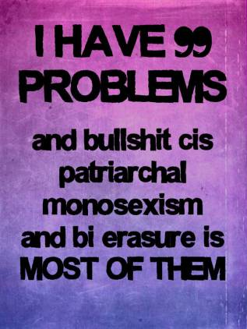
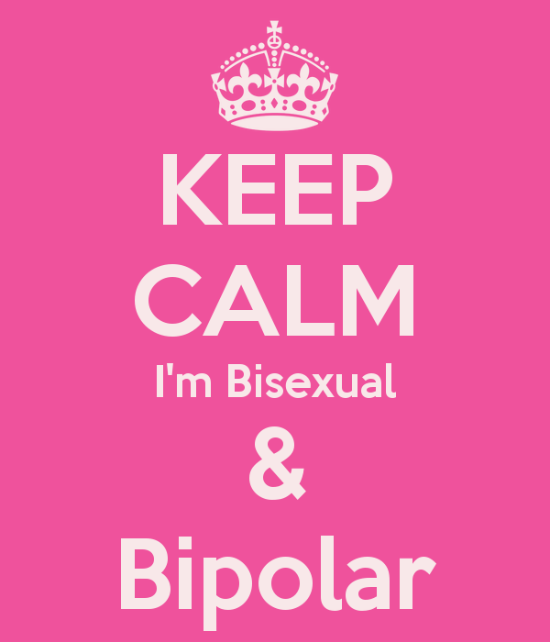
Mental Health
Bisexuals suffer higher rates of every mood and anxiety disorder.
Bi women also had more anger, self-injury, and suicidal ideation and attempts.
Among women, bisexual women had highest prevalence of PTSD (26.6% versus 6.6% of the heterosexual reference group).
“..the high prevalence of PTSD among sexual minorities in early adulthood potentially sets the stage for poorer health throughout adulthood” - American Journal of Public Health, 2012
Source: Out For Health, Healthy People 2020 Bisexual Fact Sheet
Memes from disruptingdinnerparties.com and keepcalm-o-matic.co.uk
Notes:
Click for each bullet to appear (4 bullets).

Slide 13
Suicidality
Source, Out For Health, Healthy People 2020 Bisexual Fact Sheet

Slide 14
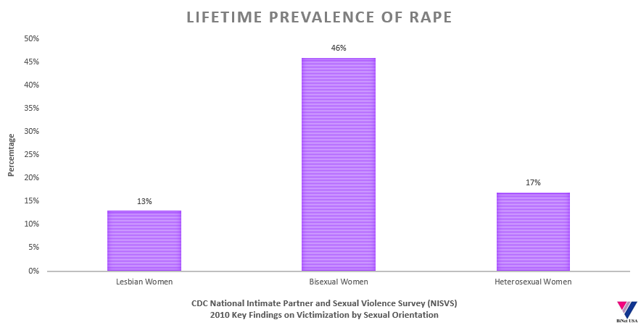
Bi women at incredible risk of rape
Most studies reveal that approximately 50% of transgender people experience sexual violence at some point in their lifetime – Journal of Aggression and Violent Behavior
Sources: Walters, M.L., Chen J., & Breiding, M.J. (2013). The National Intimate Partner and Sexual Violence Survey (NISVS): 2010 Findings on Victimization by Sexual Orientation. Atlanta, GA: National Center for Injury Prevention and Control, Centers for Disease Control and Prevention.
Notes:
Click for each bullet to appear (4 bullets).

Slide 15
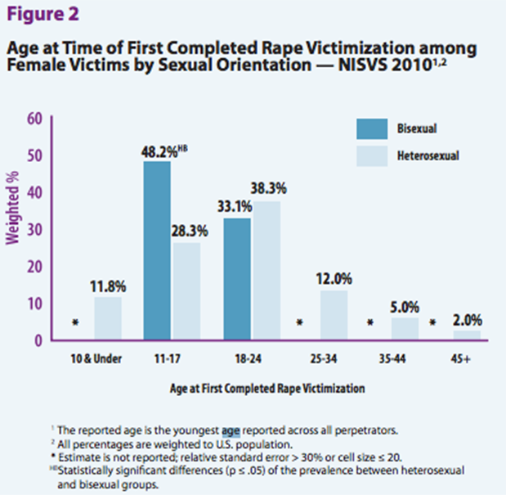
Age at time of first completed rape victimization
“Compared to lesbians, bisexual women reported more severe adult sexual victimization experiences, greater revictimization, riskier drinking patterns, and more lifetime male sexual partners.” –2013 Journal of Violence against women
Sources: Walters, M.L., Chen J., & Breiding, M.J. (2013). The National Intimate Partner and Sexual Violence Survey (NISVS): 2010 Findings on Victimization by Sexual Orientation. Atlanta, GA: National Center for Injury Prevention and Control, Centers for Disease Control and Prevention.
Notes:
Click for each bullet to appear (4 bullets).

Slide 16
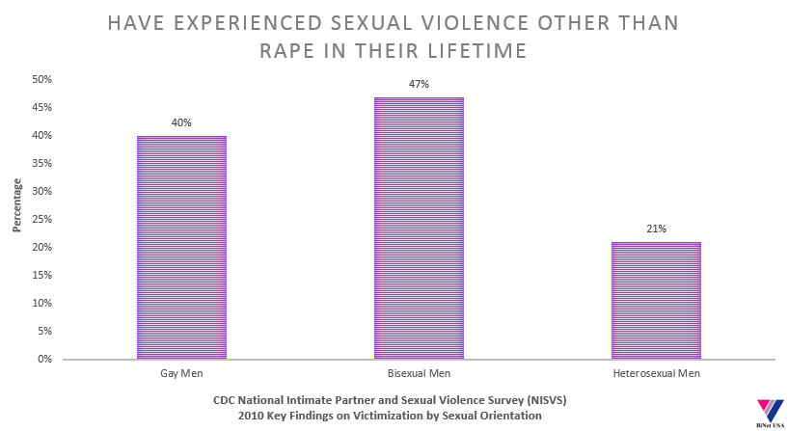
Sexual violence is a universal disparity
78% of bisexual men report having only female perpetrators of IPV
Sources: Walters, M.L., Chen J., & Breiding, M.J. (2013). The National Intimate Partner and Sexual Violence Survey (NISVS): 2010 Findings on Victimization by Sexual Orientation. Atlanta, GA: National Center for Injury Prevention and Control, Centers for Disease Control and Prevention. Stotzer, R. (2009). Violence against transgender people: A review of United States data. Aggression and Violent Behavior, 14, 170-179.
Notes:
Click for each bullet to appear (4 bullets).

Slide 17
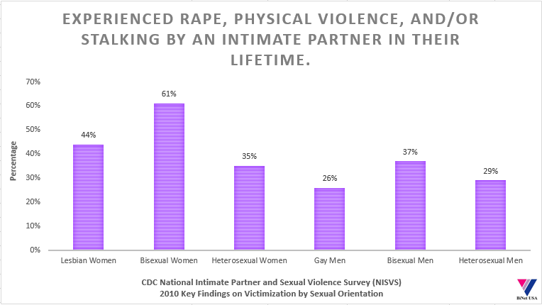
Intimate partner violence
Adult bi women reported highest levels of physical violence, rape, stalking and psychological aggression in NISVS.
90% of bisexual women report having only male perpetrators of IPV
Sources: Walters, M.L., Chen J., & Breiding, M.J. (2013). The National Intimate Partner and Sexual Violence Survey (NISVS): 2010 Findings on Victimization by Sexual Orientation. Atlanta, GA: National Center for Injury Prevention and Control, Centers for Disease Control and Prevention.
Notes:
Click for each bullet to appear (4 bullets).

Slide 18
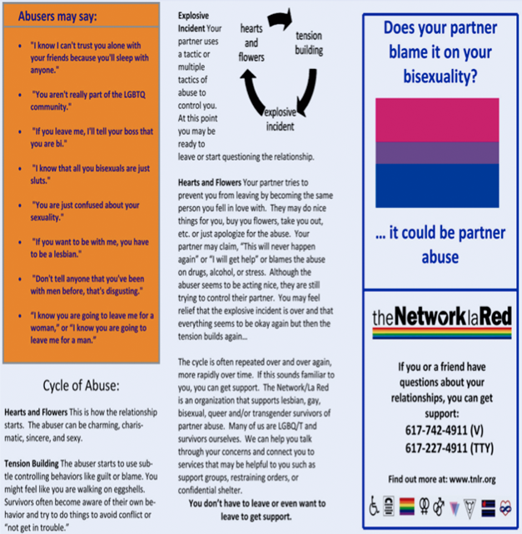
Our Stories: Intimate Partner Violence
The shelter staff told me I didn’t belong there, that they only served women abused by male partners. They referred me to a new gay community anti-battering project. That group also turned me away, saying that I was bisexual, not gay, so they couldn’t help me. What I felt too angry and defeated to say back then was, “Why can’t services be designed with bisexuals in mind? If we design services sensitive to bisexuals, they end up being responsive to both heterosexual and gay people, too, don’t they?” – From statements read at the 2013 Bisexual Community Issues Roundtable at the White House.
Domestic Violence Brochure for Bi People from theNetworklaRed

Slide 19
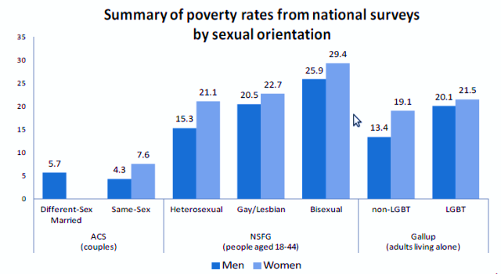
Poverty
Source, Williams Institute
Notes:
Click for each bullet to appear (4 bullets).

Slide 20
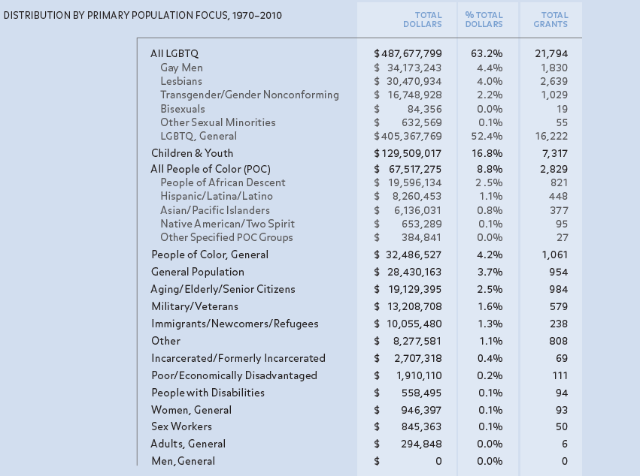
Funding disparities present in both public and private service providers and funders
Source, "40 Years Of LGBT Philanthropy" by LGBTFunders.com

Slide 21
Bisexual Workplace Discrimination
 | 2010 Survey* of Discrimination Experiences | 2012 Survey** of Discrimination Experiences
Not hired | 10% | 13%
Fired | 7% | 5%
Unfair review | 13% | 20%
Denied promotion | 10% | 13%
Denied opportunity | 17% | 7%
Sexual harassment | 25% | 31%
Anti-bi jokes | 46% | 58%
*Source: Green, Payne, Green; “Working Bi: Preliminary Findings from a Survey on Workplace Experiences of Bisexual People;” Journal of Bisexuality.
**Source: Tweedy & Yescavage; “Employment Discrimination Against Bisexuals and Others with Fluid Identities;” Social Science Research Network.
Notes:
There’s data from two surveys on this chart. The first is my survey from 2010, the second from 2012.
What this chart tells us is that bisexual workers experience quite a bit of bi-ignorance and bi-phobia on the job. According to the 2012 survey, 3 out of 5 workers are exposed to anti-bi jokes and comments on the job. A quarter to almost a third of bi workers experience sexual harassment based on their bisexuality. Sexual harassment and joking are overt, discriminatory behaviors. The rest of the categories are frustrating in a different way, because almost never will the anti-bi component of them be communicated directly. Many survey respondents reported feeling that a manager was anti-bi, but it was nothing they could prove. This frustration contributes to a feeling of powerlessness and disaffection from the workplace.
Being comfortable in the workplace is a function of feeling accepted, included, and valued. When employees experience or perceive discrimination, all three of those go out the window. Employees who are distracted from focusing on work because they feel rejected, isolated, and disapproved of are measurably poorer performers, bringing the effectiveness of the team and the organization down.
However, let me show you the impact that discrimination has overall on the psyches of bisexual employees.

Slide 22
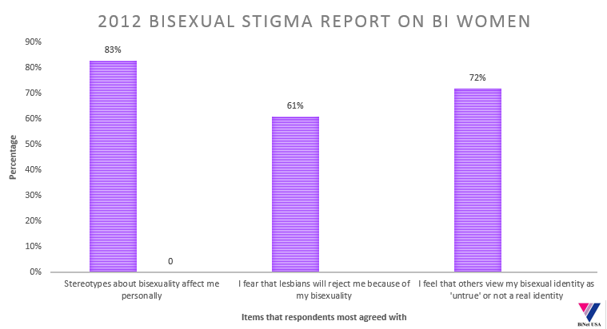
Bisexual stigma
Bisexual women often report higher rates of depression and mental health problems than their heterosexual and lesbian counterparts. These disparities likely occur, in part, as a result of the unique stigma that bisexual women face and experience. Such stigma can in turn operate as a stressor, thereby contributing to poor mental health status.
- Journal of Bisexuality, 2012

Slide 23
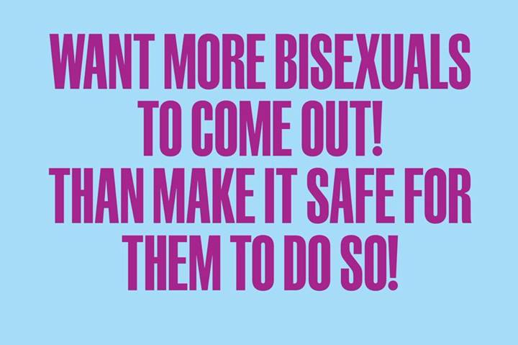
Whites
Catholics
Blacks
Jews
Pro-Lifers
Pro-Choicers
Lesbians
Gay Men
Bi Women
Bi Men
IVDU
Least stigmatized by heterosexuals
Posted on BiNet USA FB Group by college student
Most stigmatized by heterosexuals
Source: Herek, Gregory M. “Heterosexuals' Attitudes Toward Bisexual Men and Women in the United States” University of California at Davis, 2002

Slide 24
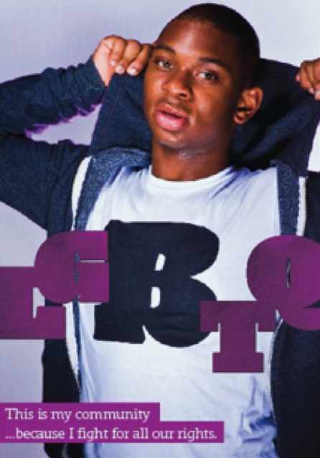
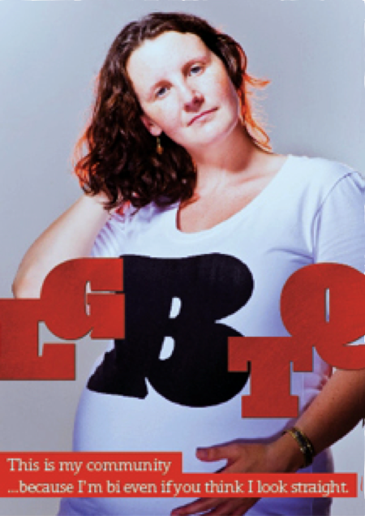
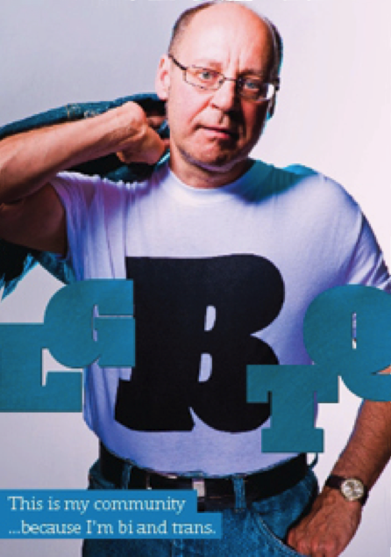
Addressing the Stigma of Bisexuality Helps Save Lives
Examples of anti-stigma campaign done by the Centre for Addiction & Mental Health, Toronto.
Posters, buttons, and postcards available for sale at http://www.rainbowhealthontario.ca/rhostore

Slide 25
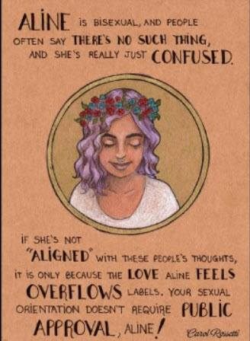
RECOMMENDATIONS
Develop bisexual-specific trainings, flyers, publications and a bisexual-specific curriculum or bisexual modules for LGBT curriculum.
Create an OPENLY bi affirming organization by displaying bisexual affirming posters, flyers and publications.
Work to remove heterosexist and homosexist assumptions from all LGBT outreach material. Do not presume that all transgender individuals are “straight” and understand that bisexual people in different-sex relationships still face health, mental health, safety and social disparities.
Research is always more actionable if you see individual LGBT communities, so break out individual groups when possible.
Regularly email, tweet, Facebook and Instagram content friendly to and inclusive of bisexual communities.
Have a bi flag on hand for Celebrate Bisexuality Day on September 23rd of every year.
CNN.com, 2014
Notes:
Click for each bullet to appear (4 bullets).

Slide 26
The Bisexual Resource Center created #BiHealthMonth for the month of March and is interested in working with LGBT organizations to develop more bi resources.
www.biresource.net

Slide 27
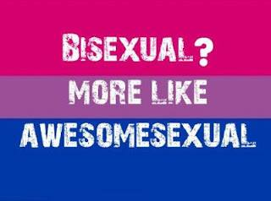
RECOMMENDATIONS
Use bi inclusive language, and a bi-claimers whenever possible:
“parents in the LGBT community” and “LGBT couples”
Different-sex and same-sex to refer to relationship type instead of “gay” or “straight” couples.
When referencing a bi identity like “pansexual”, consider including others like “fluid” or “queer” so it’s clear you support bi diversity. BPFQ FTW!
Create strong relationships with local bisexual orgs, see list on www.binetusa.org/bi-groups-in-the-us
Maintain working relationships with BiNet USA and other national bi orgs who regularly interact with the bi community. BiNet USA regularly reaches over 25k users via social media, newsletters and mailing lists.
Disruptingdinnrparties.com, 2013
RCH2411 Photography
Notes:
Click for each bullet to appear (4 bullets).

Slide 28
Questions and Comments

